Slide 1
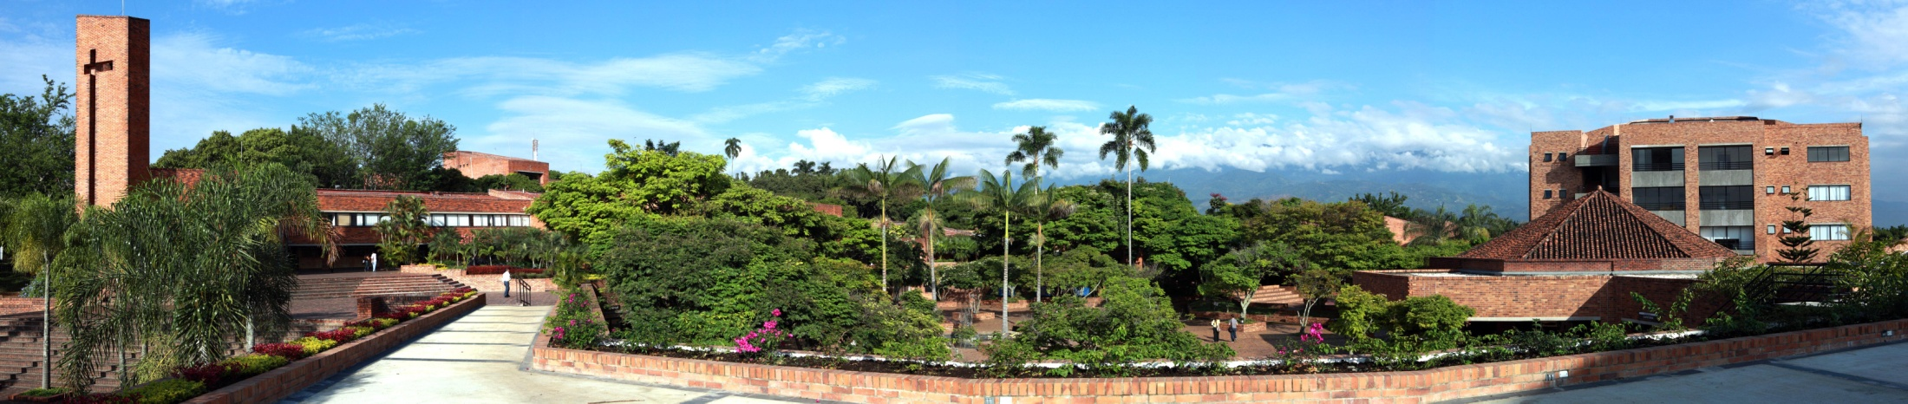
Pontificia Universidad Javeriana -Cali-

Slide 2
Colombia, Valle del Cauca, Cali: General Context
Javeriana - Cali: Key aspects
Collaborative Action research: Our approach
Where do we go from here?: Perspectives

Slide 3
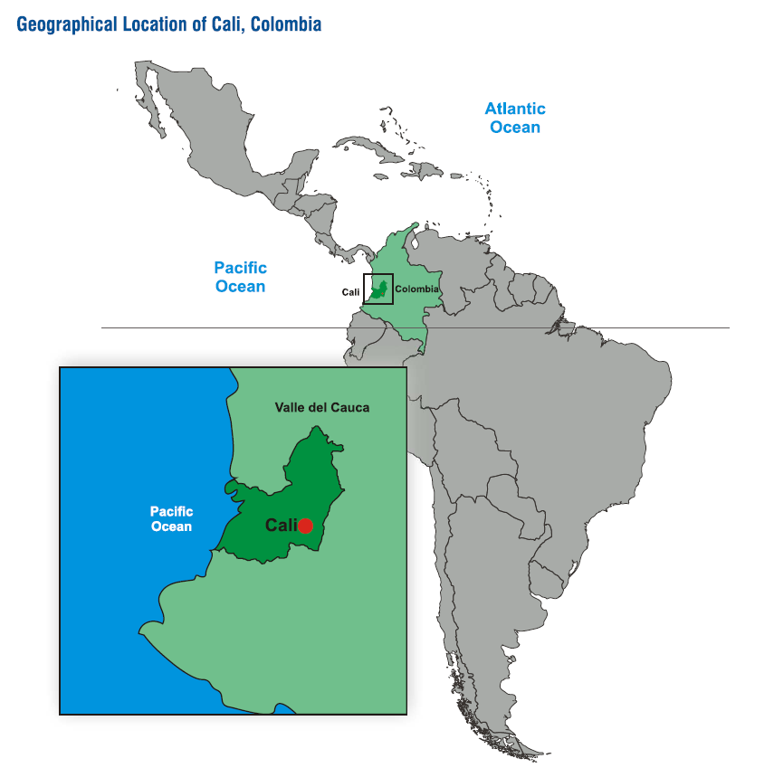
Cali, Colombia in Latin America
Cali
Colombia Population: 45 millions inhts. Area: 1.132.000 Km2 Third Largest country in South America Assets: Biodiversity Water Resources Strategic Location Natural Resources (Oil, coal, ferronickel…) Coffee culture Human diversity
Pacific Ocean
Puerto Buenaventura
Cali
ORI – 2013

Slide 4
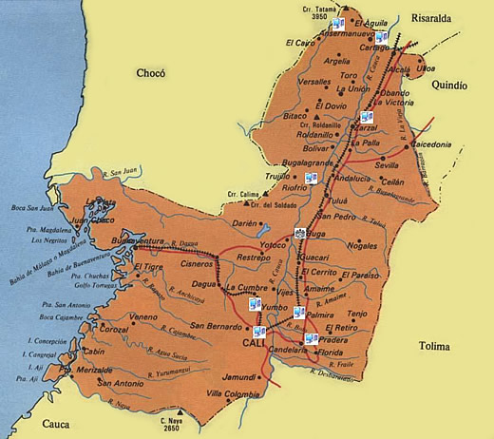
El Valle del Cauca
The Cauca Valley covers an area of 22.140 S Kms2, about 2% of the national territory.
Has a population of 4.5 million, near 11% of the population of Colombia.
About 90% live in urban centers.
ORI – 2013

Slide 5
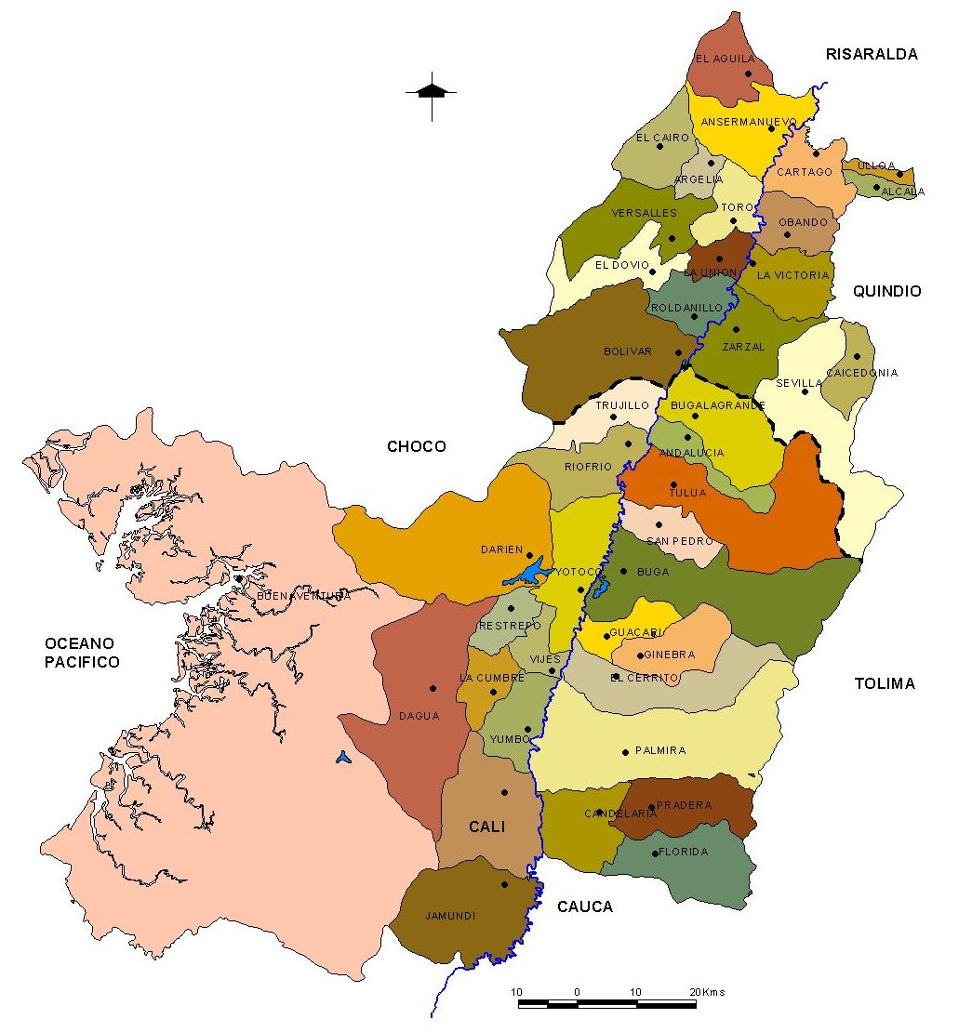
The Cauca Valley is a cluster of urban centers, 75% of the population live in cities of over 150.000 inhabitants. It is the most urbanized State in Colombia.
ORI – 2013

Slide 6
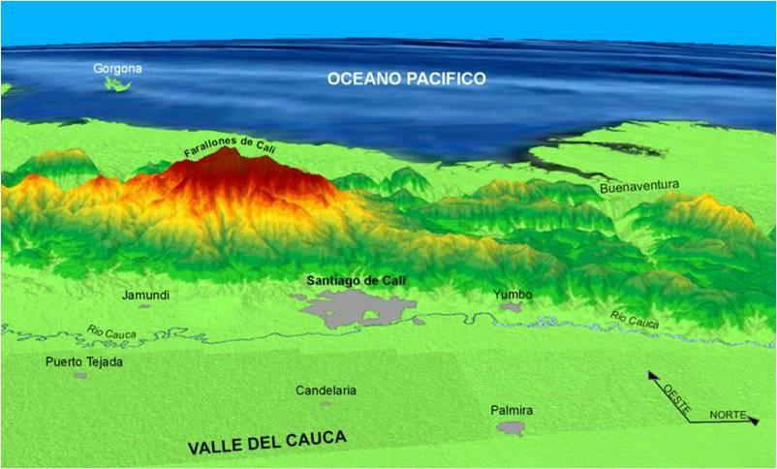

Slide 7
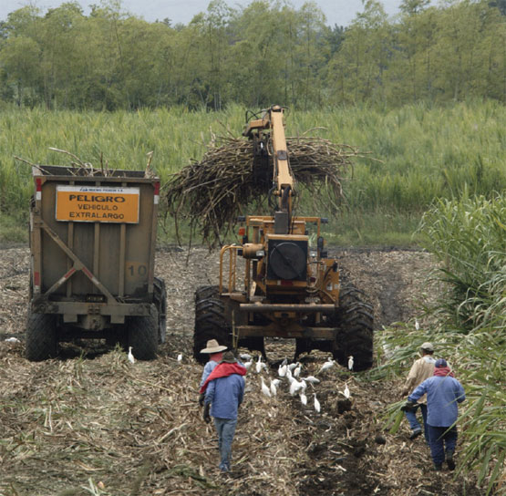
The Cauca Valley is one of the most fertile in the world and reaches one of the highest sugar cane fields in the world.
It has an agro-industry vocation.
The industry of Valle del Cauca contributes 13.81% to the national added value and its financial services have 9.75 national participation.
ORI – 2013

Slide 8
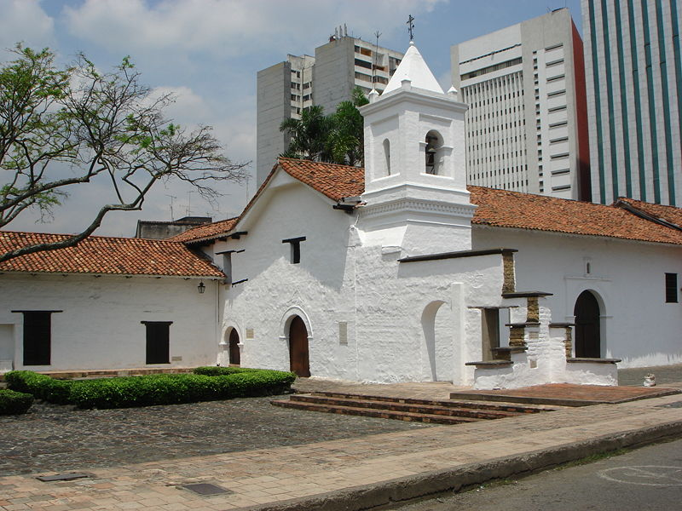
Santiago de Cali is one of the oldest cities of Colombia and in the American continent. Founded in 1536.
La Merced Church, where the first mass was celebrated 1536
Colonial architecture in foreground, modern XX Century architecture in the background.
ORI – 2013

Slide 9
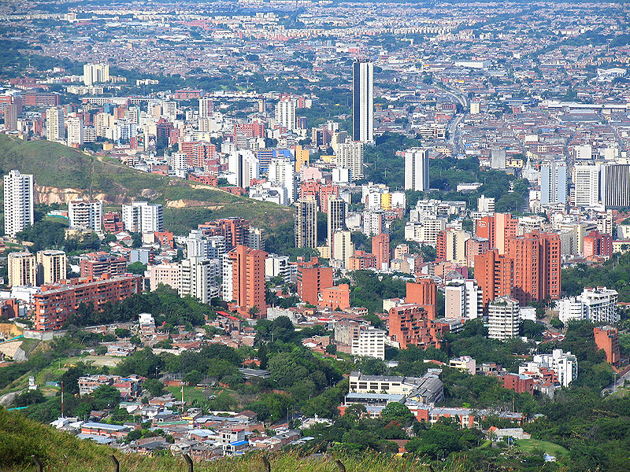
Panoramic view of Cali from the Western Mountains Monument to Christ King
51% of the population of Valle del Cauca lives in Cali and its metropolitan area. Cali boasts a population of about 2,3 million inhabitants.
ORI – 2013

Slide 10
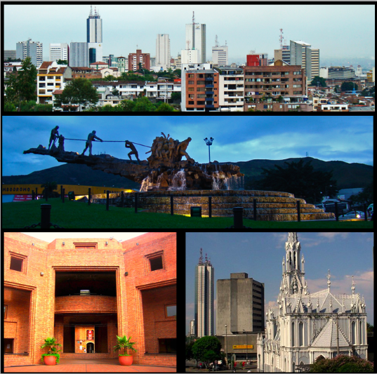
Collage of Cali: Panoramic from the Western Mountains; Monument to Solidarity, Cultural Center, Ermita Church.
ORI – 2013

Slide 11
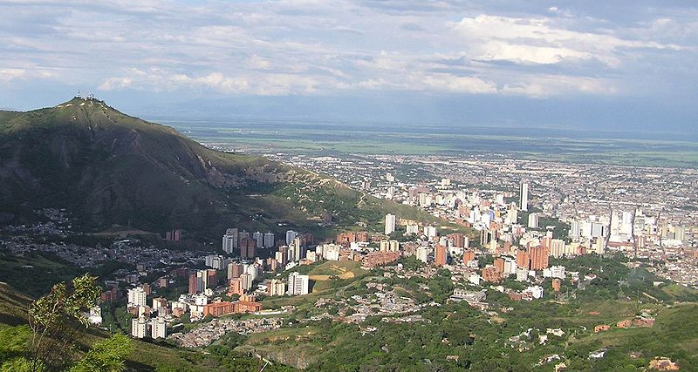
Santiago de Cali the Capital, is located in this Valley. The city is completely bordered to the West by mountains, “Los Farallones” 4000 mts high are the highest closest to the city. The Eastern part of the city is bordered by the Cauca river.
Panoramic view of Cali and of Cauca Valley at the background from the Western Mountains.
ORI – 2013

Slide 12
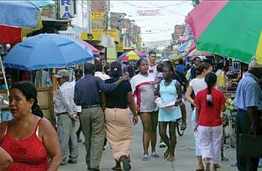
By 2005, almost 40% of its inhabitans were born in other parts of the country.
Over one third of the population in Cali is Afro-Colombian.
ORI – 2013

Slide 13
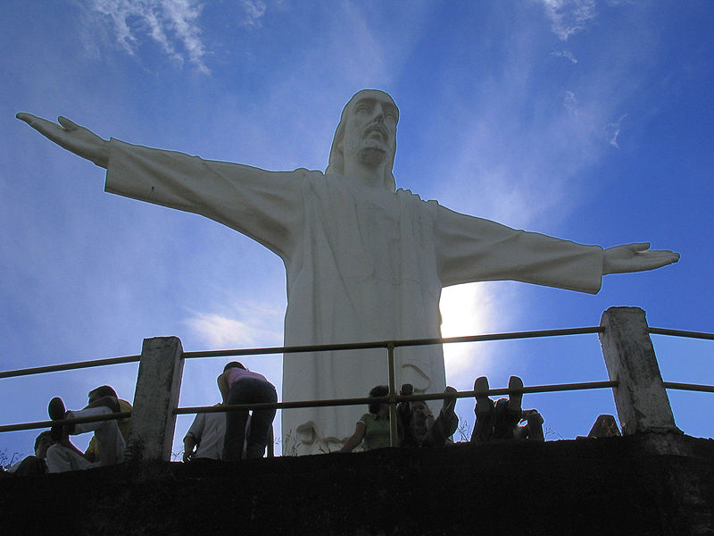
NBI (Unmet Basic Needs) 14.1% (Education, Public Services, Health…).
Unemployment fluctuates in recent years between 11% and 13.7%.
The housing deficit is 17%.
Public utilities access (water and swages) near 90%; electricity 98%.
Monument to Christ King (Cristo Rey) built by the Jesuits in 1948
Fuente: DANE
ORI – 2013

Slide 14
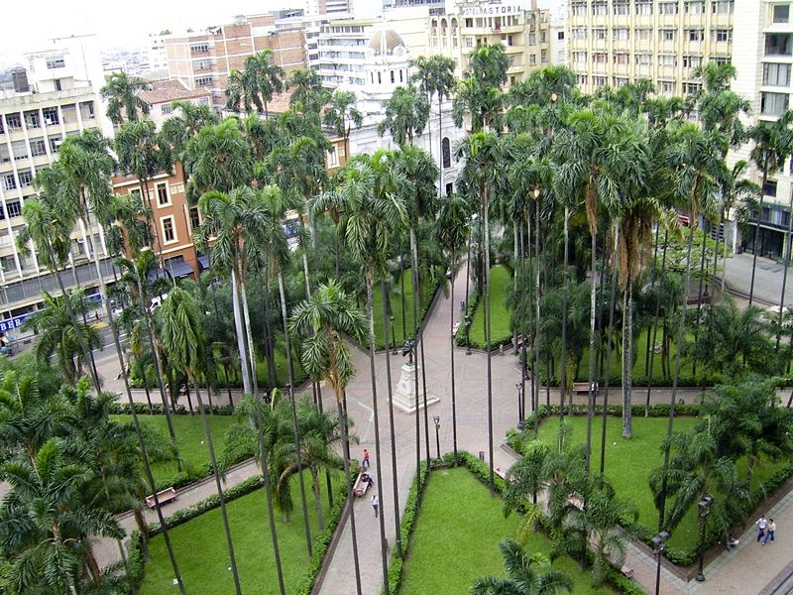
Downtown Square, Plaza de Caycedo
Health Coverage under the public subsidized system (SISBEN) for the lower income population (1 & 2) 76%
Education:
Illiteracy 4.5 %
Elementary ed.: 35%
Secondary ed.: 22%
Beyond High School: 19%
Fuente: DANE
ORI – 2013

Slide 15
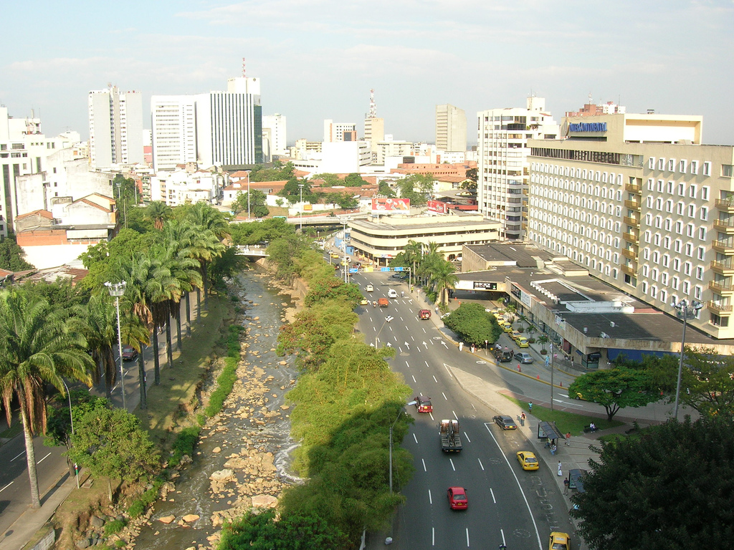
View of the Cali River and the Hotel District
Household monthly average income (2006 - 2007) $1.600.000 (Aprox. USD 800)
Insufficient 33.5%
Even 50.1%
Consider themselves poor: 42%
Members per household: 3.5
Home ownership: 50%
Fuente: DANE
ORI – 2013

Slide 16

Universidad Javeriana in Colombia
History:
Founded in 1623. First University in Nueva Granada (Bogotá).
In 1767 Jesuits were expelled from the country.
In 1844 Jesuits Returned.
In 1930 the University was re-established.
In 1970 Javeriana Cali was founded and included within its academic perspective a regional focus.
ORI – 2013

Slide 17

Javeriana Cali in numbers
Number of regular students, 2012: 6,705
Undergraduate: 5,728
Graduate: 977
Others: 6,705
About 30% of our students belong to the lowest income families of the southwestern Colombia (Valle del Cauca, Cauca y Nariño).
Alumni: 17.800.
Area of campus: 150.000 mts².
Area built: 96.000 mts².
Sports area: 20.800 mts².
152 Multimedia rooms, laboratories and classrooms.
Auditoriums with capacity for 800, 200 and 120 people.
TV Studio and Radio Station.
Building housing specialized laboratories for all academic disciplines.
Information Networks: Internet II, RENATA (Advanced National Academic Technological Network ), Javevirtual.
Center for Entrepreneurship (Campus Nova).
CAP – Center for Technological Development and Innovation of process.
ORI – 2013

Slide 18
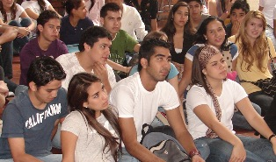
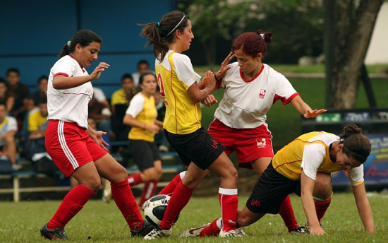
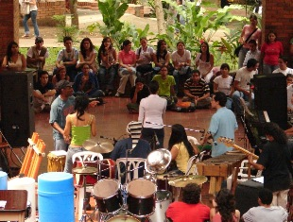
19 Undergraduate Programs
School of Engineering:
Industrial - Civil
Electronics - Computer Sciences
Applied Mathematics - Biology
School of Management and Economic Sciences:
Business Administration - Economics
Accounting - International Business and Trade
School of Humanities and Social Sciences:
Psychology - Law
Political Science - Media and Communications
Arts - Visual Communication Design
Philosophy - Architecture
School of Health:
Medicine
ORI – 2013

Slide 19
Graduate Programs :
9 Masters and 17 graduate programs
School of Engineering:
Masters Degree in Engineering (Tracks in Electronics, Industrial Engineering and Systems Engineering).
Graduate Programs: Engineering Management Systems and Construction Management; Integral Logistics; Quality Engineering.
School of Management and Economic Sciences:
Executive MBA, Double Degree: Pontificia Universidad Javeriana Cali-Temple University: Fox School of Business.
Master in Economics.
MBA.
Graduate Programs: Marketing; Finance; Health Administration; Taxation Systems Management; Social Management; International Business
School of Humanities and Social Sciences:
Masters in Family
Masters in Culture of Peace and IHR
Masters in Corporate Law
Masters in Psychology of Health
Graduate Programs: Family; Peace Culture and Human Rights; Commercial Law; Child Neuropsychology; Psychology and Organizational Development; Social Security.
School of Health
Masters in Public Health
ORI – 2013

Slide 20
University Student and Community Welfare Activities: MU- “Medio Universitario”
Universidad Javeriana Cali has established the Vice-Presidency of MU with its four Centers:
Welfare – Sports – Cultural Expression
St. Francis Xavier –Pastoral and Social Service Volunteers activities-
There are other Complementary Programs, and Deanships and Committees in each of the Schools to promote this endeavor.
International activities:
Copa Loyola: International sports event
International Corus Festival
ORI – 2013

Slide 21
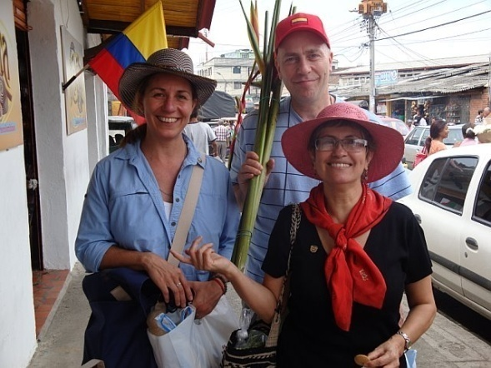
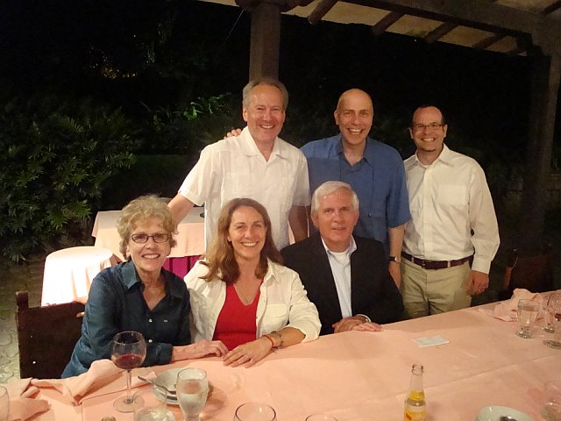
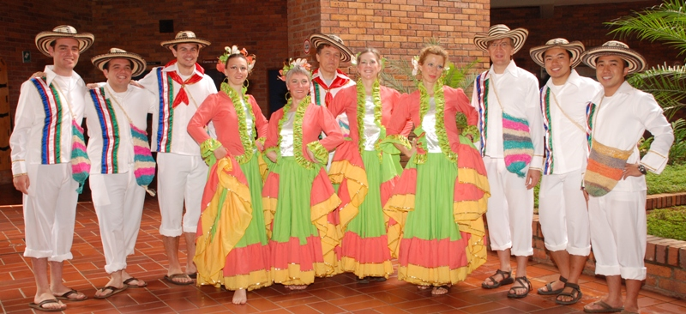
EFE PROGRAM – Spanish for Foreigners
Since 1994, Pontificia Universidad Javeriana Cali offers through its Language Academic Section this program that caters to the improvement of the linguistic skills of foreign students and perfecting their oral communication in Spanish.
The courses are designed for all those students, concurrently in an academic program or in a Spanish immersion seeking program, and for foreigners permanently or temporarily living in Colombia.
ORI – 2013

Slide 22
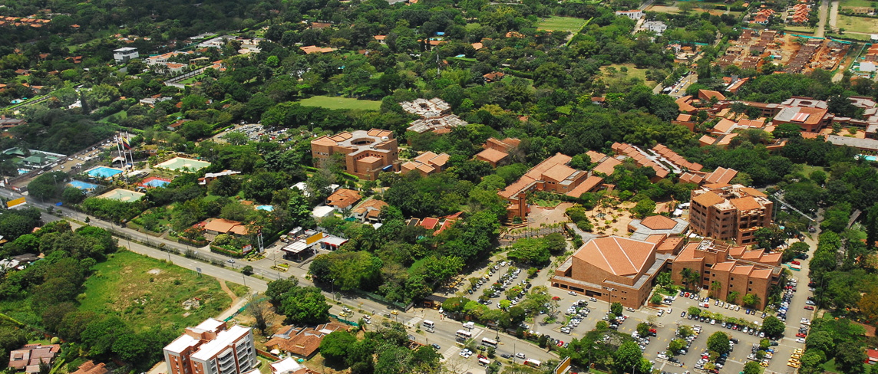
JAVERIANA CALI CAMPUS
ORI – 2013

Slide 23
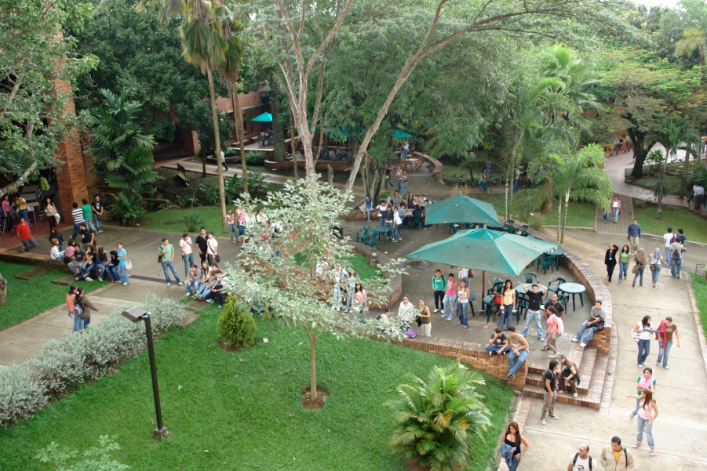
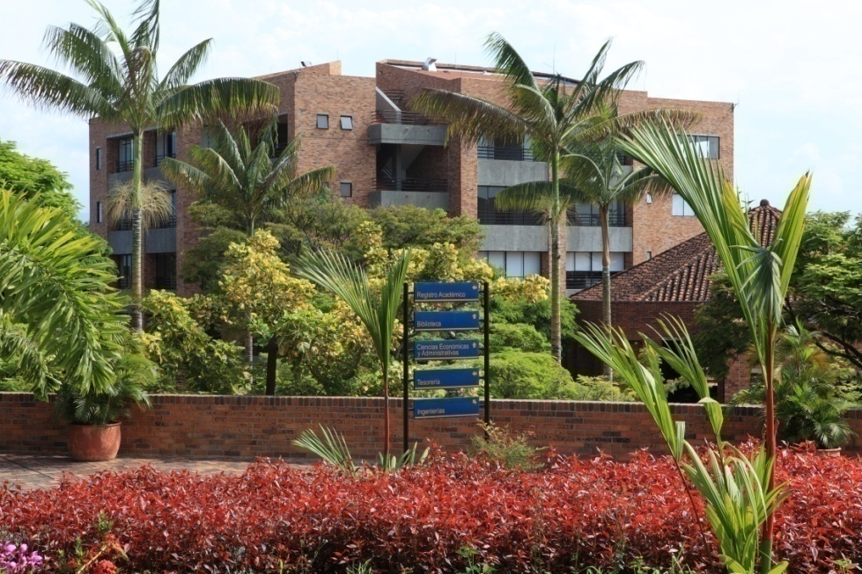
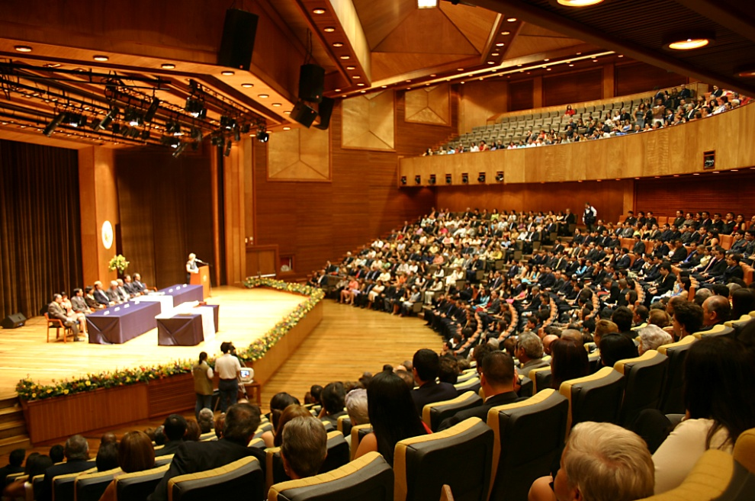
ORI – 2013

Slide 24
Strategic Areas of Research
Health
Competitivity and Development
Education
Culture and Communications
Equity and Social Inclusion
Political power, Justice and Normativity
Natural Resources, Infrastructure and Environment
Information and Communication Technologies
Human and Social developmennt within
dignified and just communities

Slide 25
Research Groups
Under/graduate Programmes
Community- based organizations
Govern/civil organizations
Mass / communitary Media

Slide 26
Some of our collaborative- (action)research experiences http://www.projectspuj.blogspot.com/

Slide 27
Where do we go from here?
Joint specific research interests: ongoing / potential projects
Student/Faculty mobility
Peer networking (Tutoring, evaluation, peer reviewing)
Do visit!!

